Slide 1
Nested Classes

Slide 2
Inner Classes
Nested classes are used to logically group classes or interfaces in one place, for more readability and maintainability.
Nested class can access all members of the outer class including the private data members and methods.
Two types:
Non-static nested class (inner class)
Static nested class

Slide 3
Member Inner class - Example
class Outer{
int data = 30;
private int val = 20;
class Inner{
void show() {
System.out.println("Data=:"+data+"Value="+val);} }
}
class test{
public static void main(String args[]) {
Outer o = new Outer();
Outer.Inner in = o.new Inner();
in.show();
} }

Slide 4
Member Inner class
Compiler creates two class files of the inner class
Outer.class and Outer$Inner.class
To instantiate the inner class, the instance of the outer class must be created
The inner class have a reference to the outer class, thus it can access all the data members of the outer class.

Slide 5
Anonymous Inner Class
Class with no name
Used when a method or interface is to be overridden

Slide 6
Anonymous class - Example
abstract class Outer{
int data = 30;
abstract void show();
void print() {
System.out.println("Within Print");
}
}
class test {
public static void main(String args[]) {
Outer o = new Outer() {
void show() {
System.out.println("Data=:"+data);}
};
o.show();
o.print();
}}

Slide 7
Anonymous Class
The name of the class created is decided by the compiler
In the given example, the anonymous class extends the ‘Outer’ class and gives implementation for the show() method.
The object of the anonymous class can be referred by the reference variable ‘o’
Anonymous class cannot have additional methods because it is accessed using the reference to the ‘Outer’ class

Slide 8
Anonymous Inner Class using Interface-Example
interface Outer{
int data = 30;
void show();
}
class test {
public static void main(String args[]) {
Outer o = new Outer() {
public void show() {
System.out.println("Data=:"+data);
//data =25; // Error
}
};
o.show();
}
}

Slide 9
Local Inner Class-Example
class Outer{
private int data = 30;
void show() {
int val =50;
class inner{
void print() {
System.out.println("Value= "+val+"Data="+data);}}
inner i =new inner(); // Creating a named type
i.print(); }
}
class test {
public static void main(String args[]) {
Outer o = new Outer();
o.show();
//o.print(); //Error}
}
Note:
Local inner class can be instantiated only within the method it is defined.

Slide 10
Static Inner Class-Example
class Outer{
static int data = 30;
private static int val = 20;
static class Inner{
void show() {
System.out.println("Data=:"+data+"Value="+val);
}
}
}
class test{
public static void main(String args[]) {
Outer.Inner in = new Outer.Inner();
in.show();
}
}

Slide 11
Static Inner Class
A static class created inside a class.
It can access the static data members of the outer class including the private members.
It cannot access the non-static members and methods.
The object of the outer class need not be created, because static methods or classes can be accessed without object.
Note: Only inner classes can be prefixed with the static keyword.

Slide 12
Packages

Slide 13
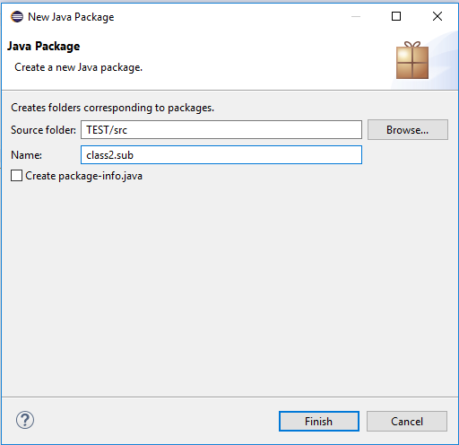
Create a package & sub package
Project 🡪 New 🡪 Package

Slide 14
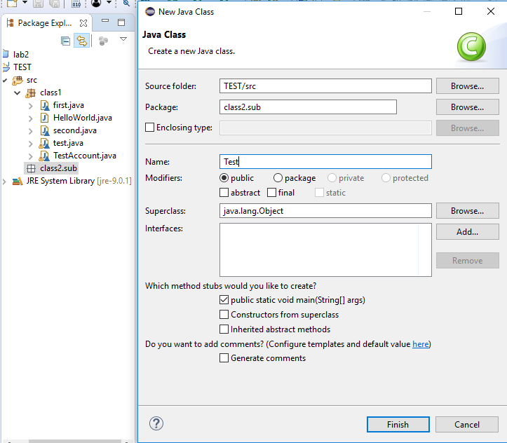
Create a class within the package
Package 🡪 New 🡪 class

Slide 15
Class within the package
package class2.sub;
public class Test {
public static void main(String[] args) {
// TODO Auto-generated method stub
}
}

Slide 16
Importing a package
package class2.sub;
import class1.*;
public class Test {
public static void main(String[] args) {
HelloWorld h = new HelloWorld();
h.show();
}
}
package class1;
public class HelloWorld
{
public void show() {
System.out.println("Within class 1's show");
}
}

Slide 17
Importing a class
package class1;
public class HelloWorld
{
public void show() {
System.out.println("Within class 1's show");
}
}
package class2.sub;
import class1.HelloWorld;
public class Test {
public static void main(String[] args) {
HelloWorld h = new HelloWorld();
h.show();
}
}

Slide 18
Access Modifiers
Access Modifier | within class | within package | outside package by subclass only | outside package
Private | Y | N | N | N
Default | Y | Y | N | N
Protected | Y | Y | Y | N
Public | Y | Y | Y | Y

